Slide 1
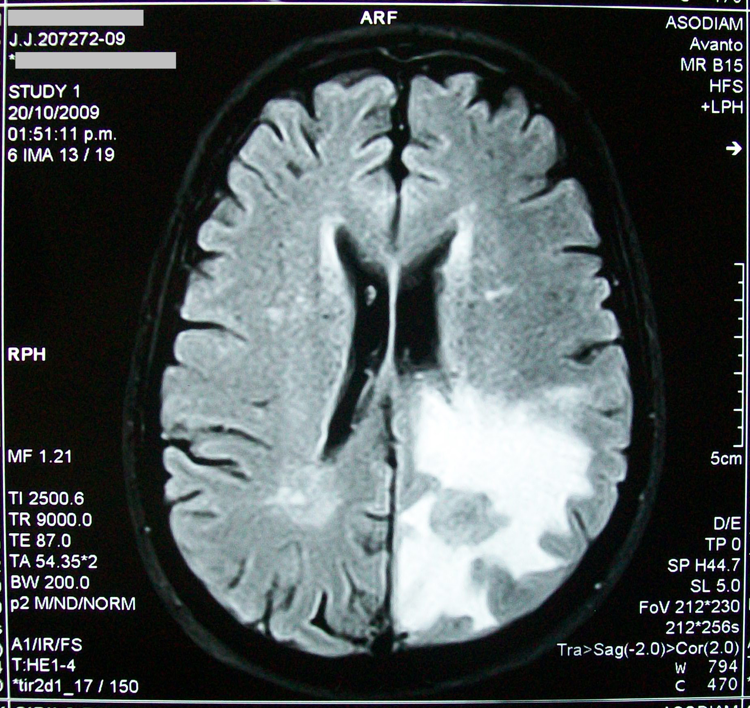
Complex System Simulations
Cellular Automata Model for Tumor Growth
By: Imaan Bijl, Gelieza Kotterheinrich, Zainab Nasser

Slide 2
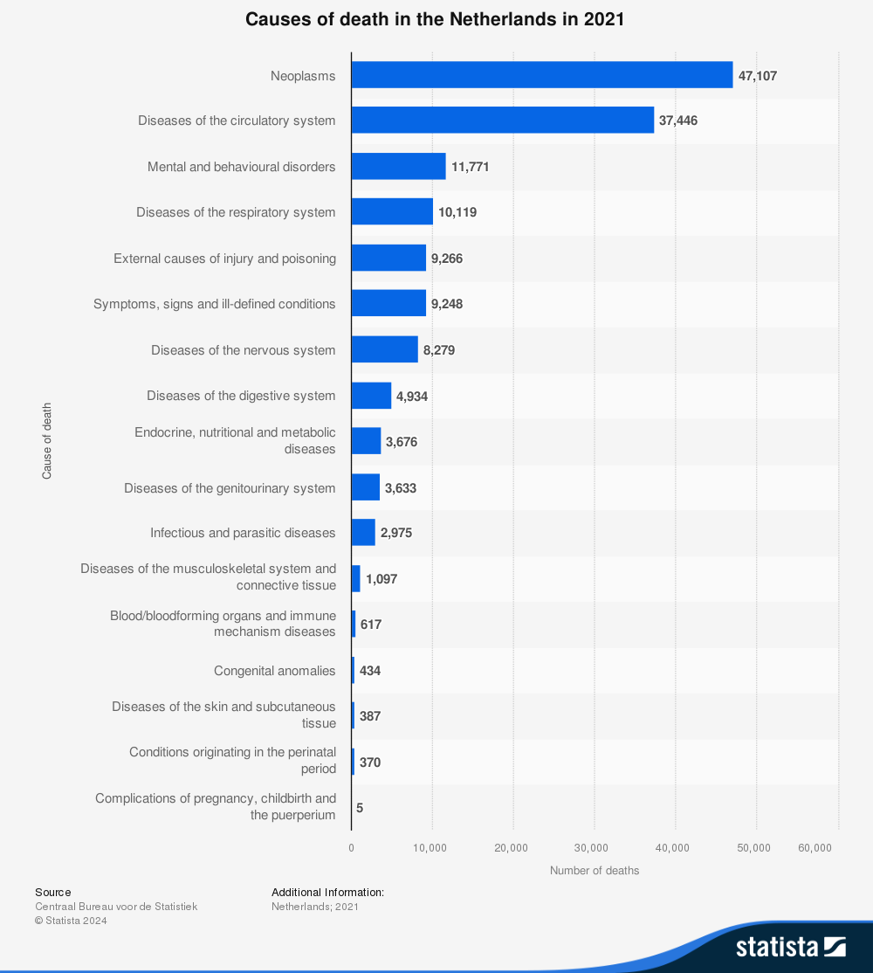
Introduction
Leading cause of death in the Netherlands
Characteristics of tumors
Proliferation
Mutation
Invasion/Metastasis
Environmental influence (Nutrients, oxygen, immune cells)
In our model: proliferation, mutation, oxygen
Notes:
Tumor growth results from individual cells interacting with each other. A tumorous cell can grow by duplicating, move to other places (metastasis) and duplicate there, or die. The growth of a tumor is also dependent on the provision of nutrients (oxygen) or presence of immune cells.
In our model: we look at mutation probability,

Slide 3
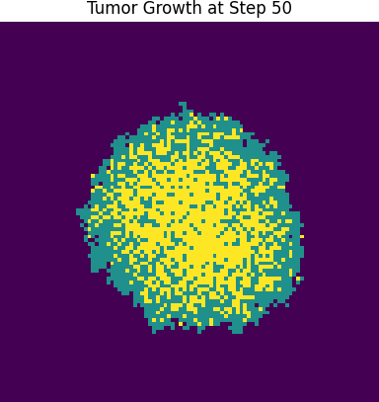
Basic Model
Cellular automaton
2D grid
Healthy (0)
m = 0
Tumorous(1)
0< d<1
Necrotic (2)
0< p < 1
Infect healthy neighbor
Notes:
Explain mutation probability, death and growth probability

Slide 4
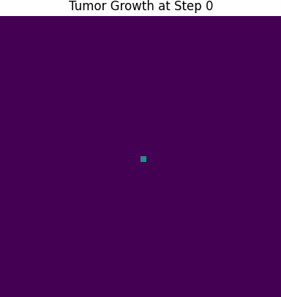
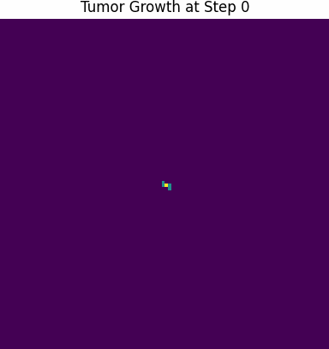
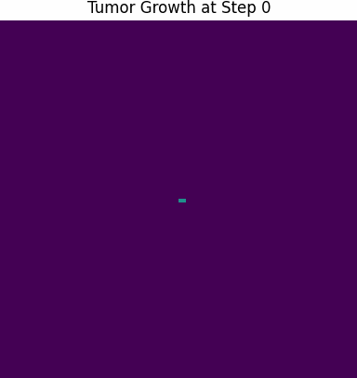
Basic Model: growth vs. death probability
p << d : immediate death p ~ d: finite size (dead) tumor p >> d: infinite growth, then death
Notes:
N=100, T=150
P ~ d

Slide 5
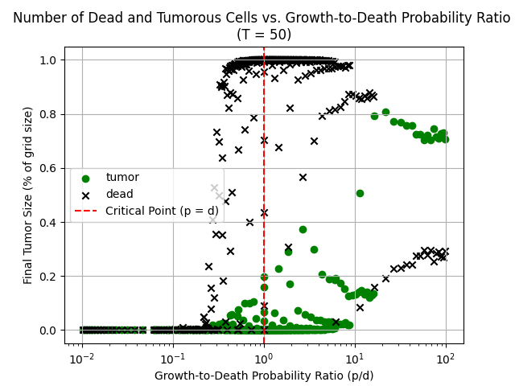
Tumor size
Notes:
Supplementary : dead cells included

Slide 6
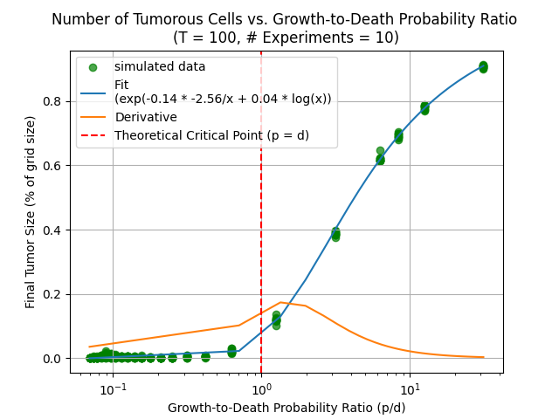
Tumor size
Second order phase transition

Slide 7
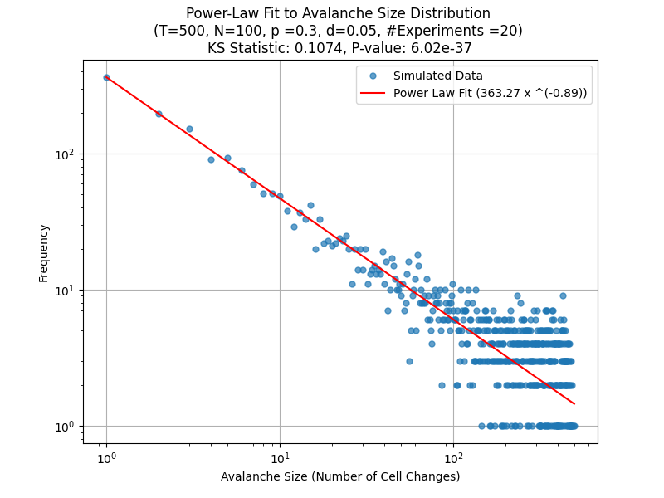
Avalanche size
distribution
p > d
Notes:
Number of cell changes in one iteration.
Picture: also follows a powerlaw (up to a ratio of 40 or 60, when the p and r values are not meaningful anymore, we get powerlaw distributions). There are more avalanches in general, because the tumor dies less quickly (death rate is smaller than in middle picture) and therefore we get more growth events and the tumor growths for longer before it becomes extinct.
Below the critical threshold we do not get a power law distribution, because we don’t get any avalanches at all because the tumor dies.

Slide 8
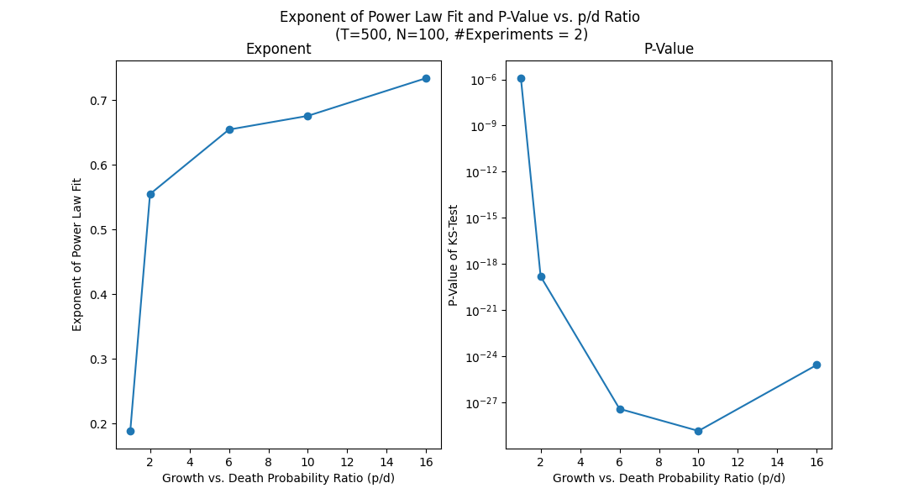

Slide 9
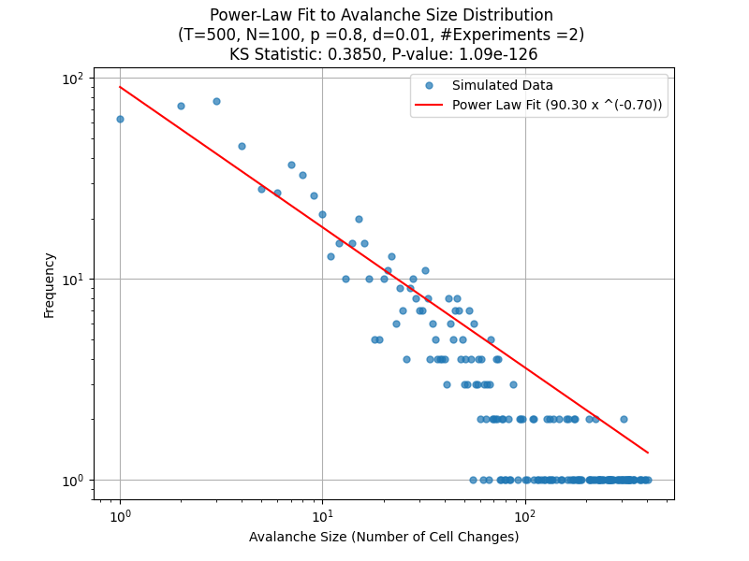
Notes:
Example of a fit with an even larger p/d ratio of 80.

Slide 10
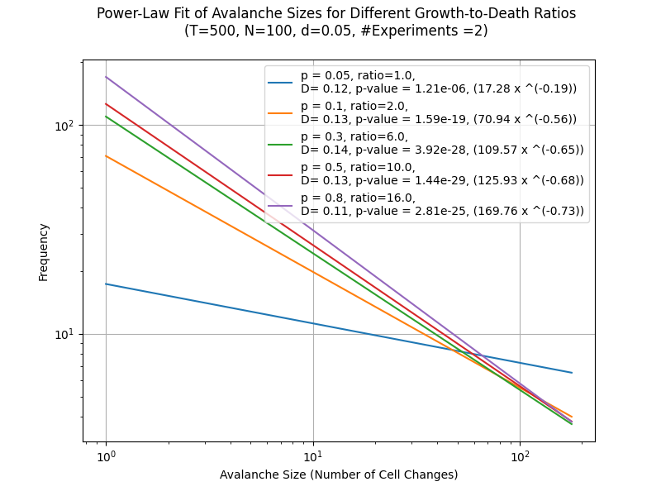
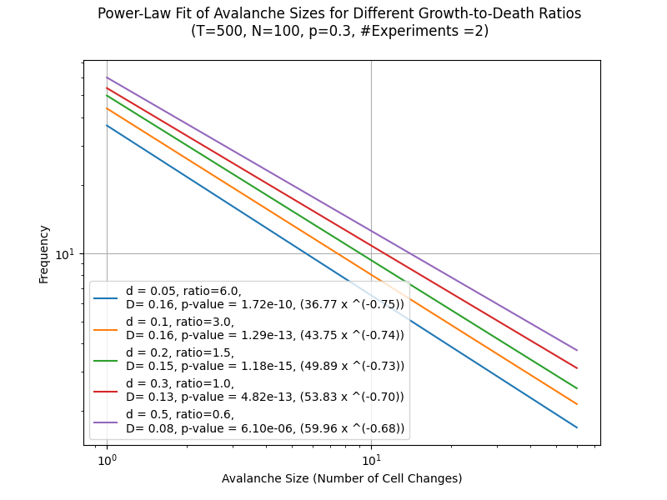
Avalanche size distribution
Notes:
Similar to sand pile model: distribution of size of avalanches follows power-law, exponents < -1
Many biological or physical phenomena follow this distribution, like the degree distribution in real networks or the avalanche sizes in sandpile model, Pareto’s law of income distribution.

Slide 11
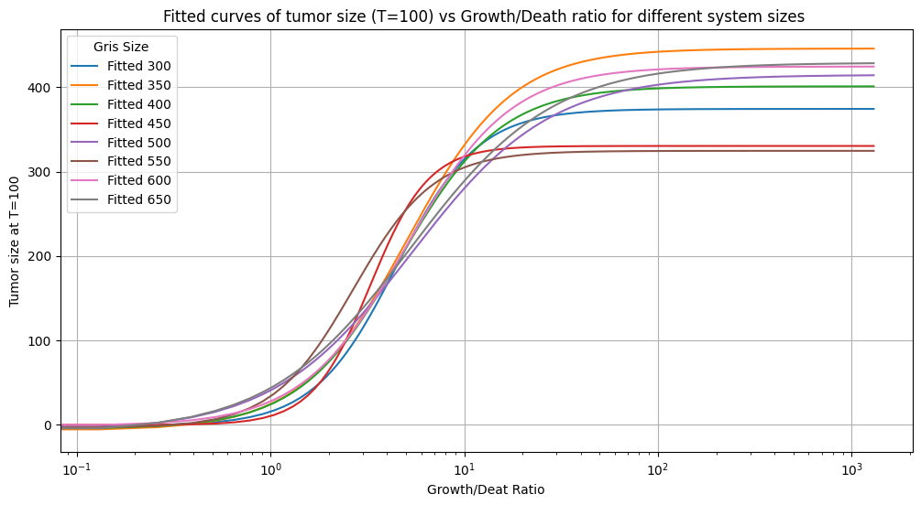
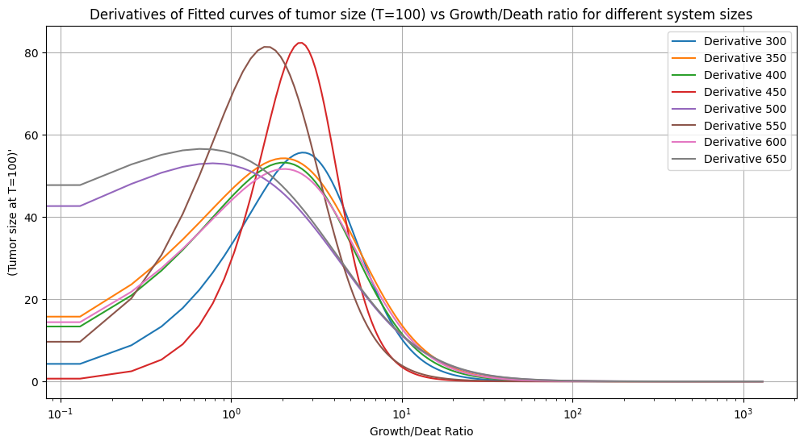
Tumor size at T=100
for different system sizes and growth/death ratios
Notes:
Text:
We wanted to test this for a couple more grid sizes, to be able to confirm that the critical point for an infinite system is 1. . Therefore we measured tumor size in different size systems at timestep 100 for different ratios of growth and death. To These points, we fitted curves of which we then took the derivative. Our expectations were that the x value, so the ratio of growth death, at wich the derivative showed a peak would converge to 1, the critical point, as system size increased.

Slide 12
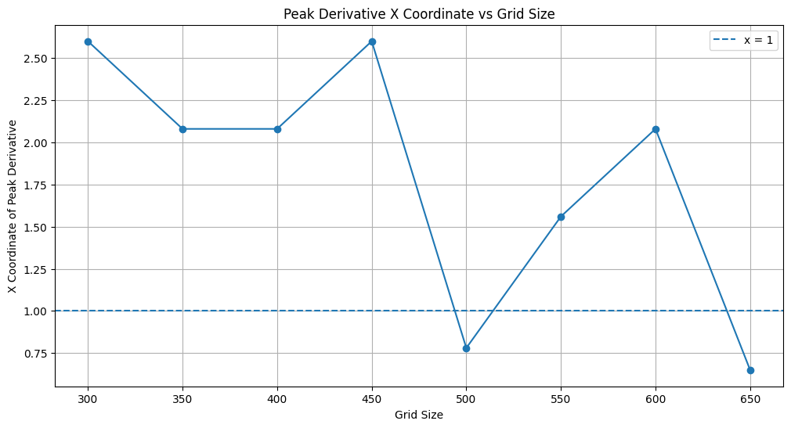
Max Derivative of Tumor Growth
Notes:
Unfortunately it requires some fantasy to see convergence is the plot of the x-values of the peak and the grid size. We suspect this could be due to poor fitting of te he datapoints or on having to few iterations.

Slide 13

Extension 1: Mutation probability
Healthy (0)
m > 0
Tumorous(1)
d
Necrotic (2)
p
Infect healthy neighbor
Notes:
Next im going to talk about the first extension to our model which is a mutation probability. You can observe that new tumor clusters emerge that are not connected to the previous tumors. Could model the emergence of metastases, although metastasis probably emerges from

Slide 14
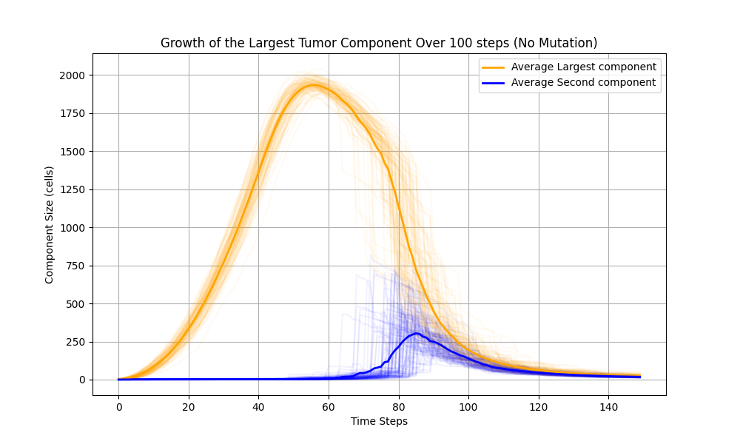
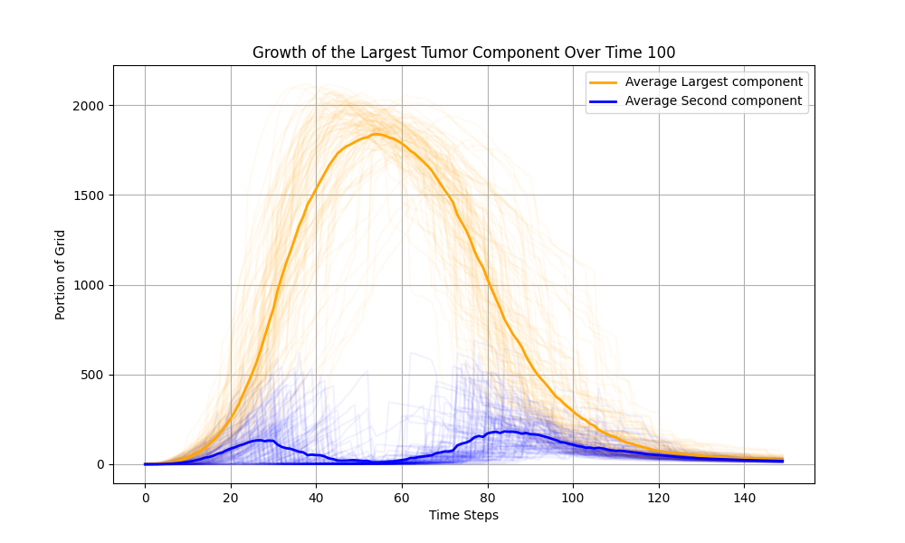
Largest vs Second Largest component
Notes:
These figures clearly show the different emergent patters between the model with and without mutation. Here in the first mode e see the rapid growth of the largest component which at some point gets cut in half at which th second largest component arrives. In a model with mutation however, the second largest component starts immetedly, gets swallowed up by the largest component and then re-emerges as the largest component is cut in half by the death again

Slide 15
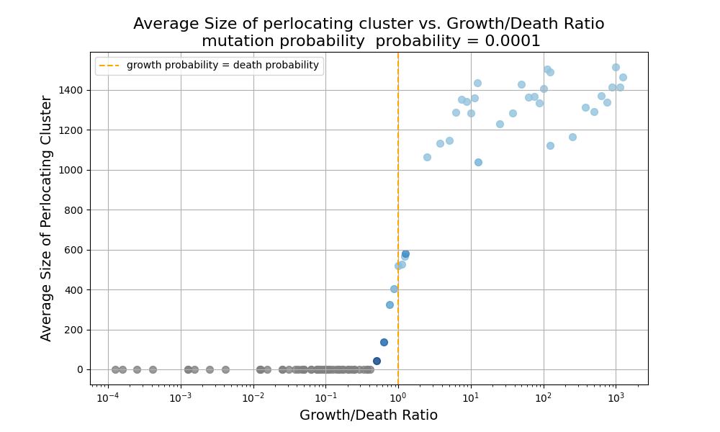
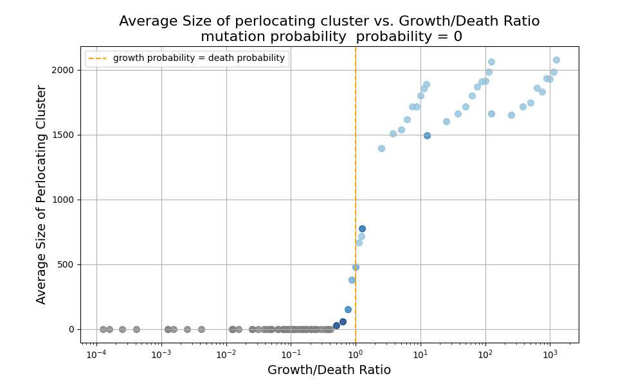
Percolation: Growth/Death ratio vs First percolating cluster size
Notes:
For cancercells, it makes sense to study percolation, since it implies a wide spread of the cancer cells, which is th epoint at which cancer becmomes dangerous since its deppleating recourses and pressing into other organs. Therefore we measured th esize of the first percolating clusters at 1000 time steps. We see percolation only takes of just before the critical point. For mutation model, percolation starts Before the pricital point, since it contributes to tumor growth

Slide 16
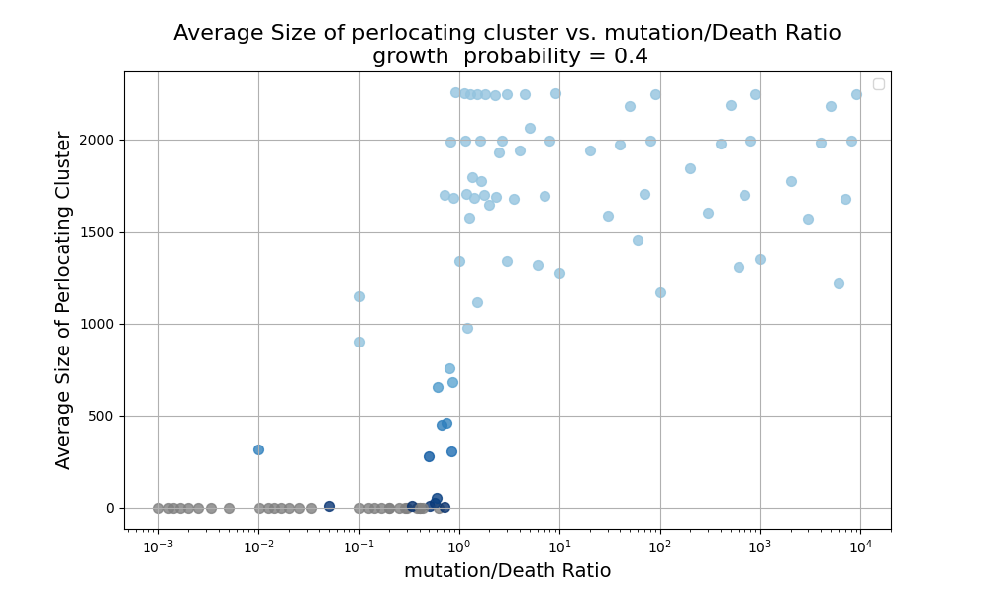
Percoaltion: Growth/Death ratio vs First perlocating cluster size

Slide 17
Model Extension 2: Oxygen Levels
Hybrid 2D cellular automata
Cells attempt to reproduce at each time step
Cell death depends on local oxygen levels
Oxygen threshold is lower for cancer cells
Healthy (1)
Cancer (2)
p = 0.6
O₂ < Threshold
p = 0.6
Healthy (1)
Healthy (1)
Death
(0)
Quiescent
(3)
Cancer (2)
Cancer (2)
> 75 Time Steps
O₂ > Threshold
Death
(0)
Cancer (2)
Notes:
To further highlight the complexity of tumours, we added a continuous field of oxygen on the grid
Hypotheses:
The interaction between oxygen and the normal and cancerous cells exhibits emergence.
A critical level of oxygen exists such that a tumour becomes invasive

Slide 18
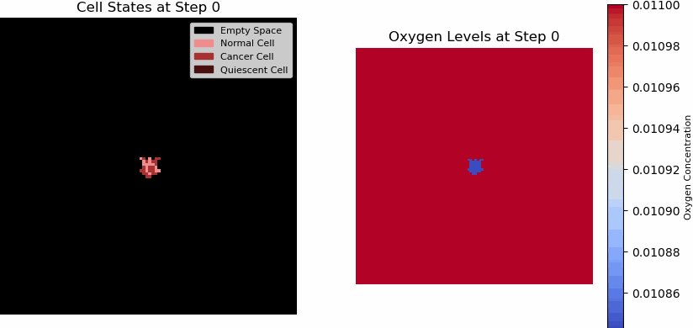
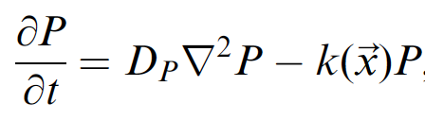
Model Extension 2: Cellular Automata
Notes:
This model uses an initial oxygen level of 0.015g, an oxygen level that was proven to show all states.
Model begins with a 5x5 cluster of normal cells and cancer cells randomly distributed with a probability of placement at 0.5 and evolves based on the rules.
Oxygen is a continuous field modeled with the shown PDE
The pattern shows immediate clustering, firstly (and most obviously) due to cell division/reproduction of cells of the same type, but also due to the fact that cells are more likely to survive when surrounded by cells of its own type.
Eventually, in the hypoxic state due to cells uptaking the oxygen, most cells become quiescent with the ability to become cancer cells again if the oxygen level replenishes.

Slide 19
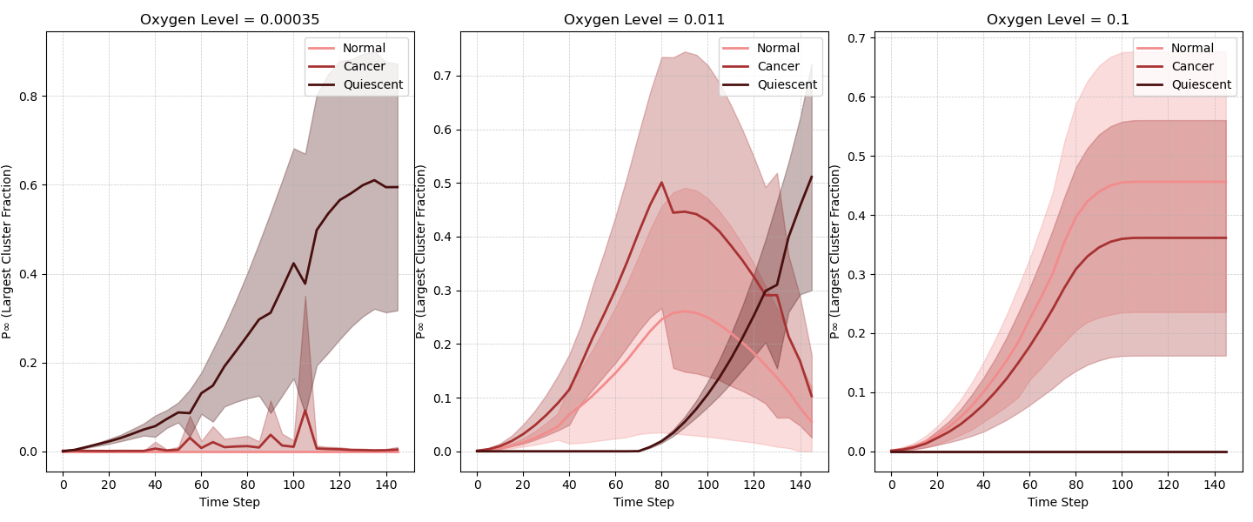
Model Extension 2: Largest Clusters (P∞)
Notes:
At lower oxygen, the tumour exists in a perfect hypoxic state where normal cells do not survive but the cancer and quiescent cells do.
Higher than the critical point, at the level of oxygen used in the original simulation, all cells exhibit growth but the quiescent cells persevere due to oxygen uptake
When oxygen is very high, both normal cells and cancer cells persevere, with no cells becoming quiescent (infinite growth)
This shows 3 distinct “states” of a tumour

Slide 20
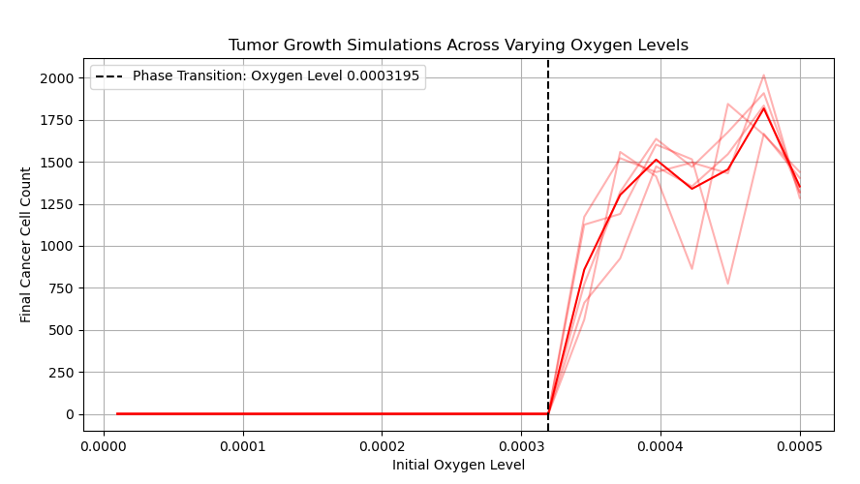
Model Extension 2: Phase Transition
Another hypothesis arises!
Due to this very distinct phase transition, we expect the the tumour to exhibit the most complex behaviour near or at this critical point → increase in fractal dimension ?

Slide 21

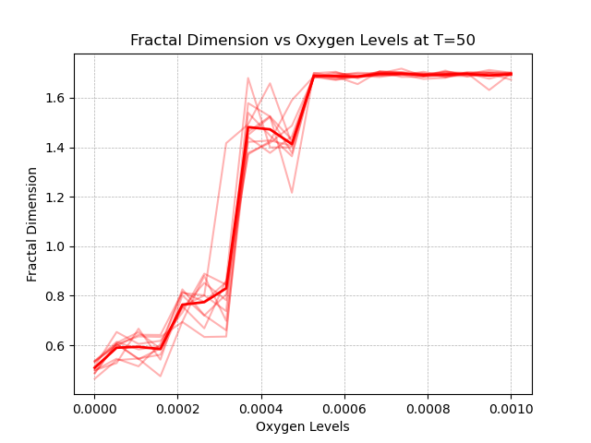
Model Extension 2: The Critical Point

Slide 22


Discussion
Results
Tumour cells interact locally with normal cells and their local ecology such that tumours emerge
There exists a critical threshold of the P/D ratio in which cancer cells develop into a tumour (≅1)
There exists a critical threshold of the oxygen level in which cancer cells develop into a tumour (≅ 0.00032 g)
Tumours are complex systems!
Limitations
While our models provide useful insight into tumour complexity and points of criticality, it lacks important biological features such as nutrient availability, blood vessels, and oxygen heterogeneity due to computational limitations and time.

Slide 23


Discussion
Further Research
Moderating oxygen as a treatment
Modeling heterogeneity throughout the cell for further realism (ex. blood vessels)
Researching the spread to other tissue (metastasis)
Exploring fractal dimensions further to determine why complexity does not decrease again when tumour is large
Conclusion
By simulating tumours using cellular automata, we were able to explore characteristics of complexity such as patterns of emergence, clustering, percolation, and behaviour around critical points.

Slide 24
References
[1] Aguadé-Gorgorió, G., Anderson, A. R. A., & Solé, R. (2024). Modeling tumors as complex ecosystems. iScience, 27(9), 110699. https://doi.org/10.1016/j.isci.2024.110699
[2] Bertout, J. A., Patel, S. A., & Simon, M. C. (2008). The impact of O2 availability on human cancer. Nature reviews. Cancer, 8(12), 967–975. https://doi.org/10.1038/nrc2540
[3] Centraal Bureau voor de Statistiek. (2022, December). Netherlands: Causes of death 2021 . Statista. https://www.statista.com/statistics/520529/netherlands-causes-of-death/
[4] Philip Gerlee and Alexander R. A. Anderson. “An evolutionary hybrid cellular automaton model of solid tumour growth”. In: Journal of Theoretical Biology 246.4 (June 2007), pp. 583–603. doi: 10.1016/j.jtbi.2007.01.027. url: https://doi.org/10.1016/j.jtbi.2007.01.027.
[5] T. Alarc´on, H.M. Byrne, and P.K. Maini. “A cellular automaton model for tumour growth in inhomogeneous environment”. In: Journal of Theoretical Biology 225.2 (2003), pp. 257–274. issn: 0022-5193. doi: https://doi.org/10.1016/S0022-5193(03)00244-3.url: https://www.sciencedirect.com/science/article/pii/S0022519303002443.

